Slide 1
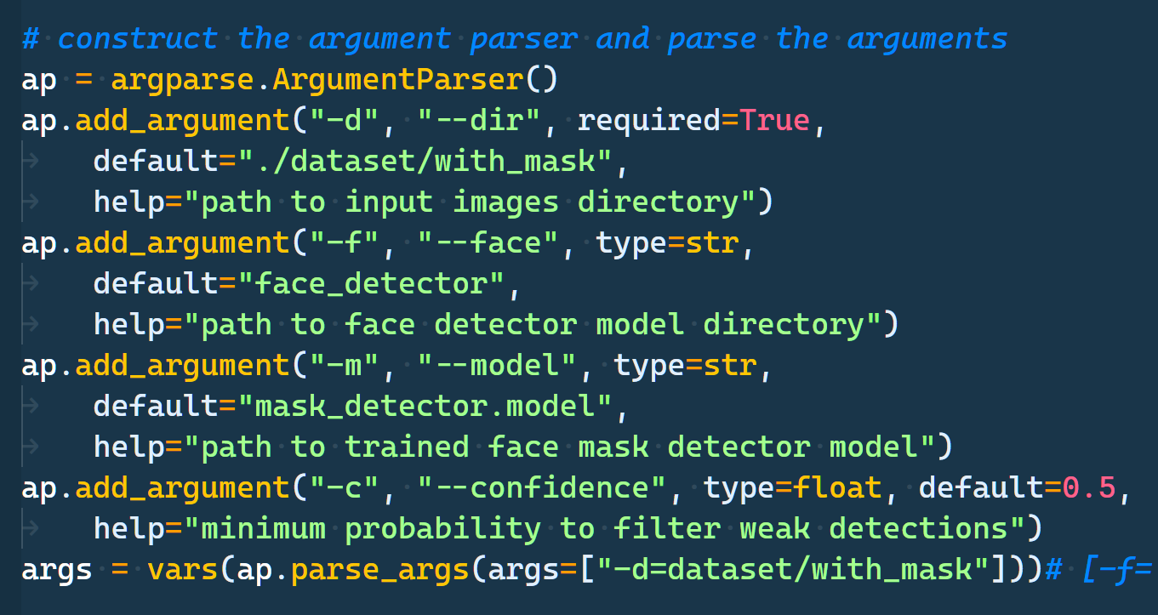

Slide 2
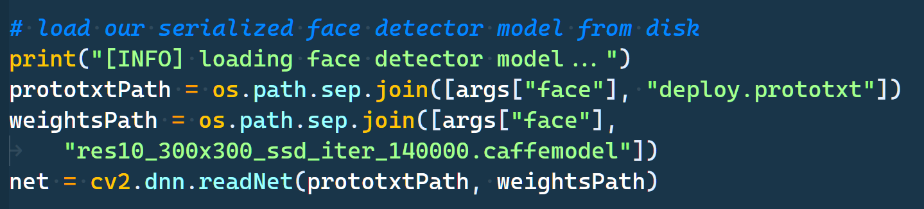
Caffe...
To use a pre-trained Caffe model with OpenCV DNN, we need two things. One is the model.caffemodel file that contains the pre-trained weights. The other one is the model architecture file which has a .prototxt extension. It is like a plain text file with a JSON like structure containing all the neural network layers’ definitions. To get a clear idea of how this file looks, please visit this link.
We are using a function called readNet() from the OpenCV DNN module, which accepts three input arguments.
model: This is the path to the pre-trained weights file. In our case, it is the pre-trained Caffe model.
config: This is the path to the model configuration file and it is the Caffe model’s .prototxt file in this case.
framework: Finally, we need to provide the framework name that we are loading the models from. For us, it is the Caffe framework.
Along with the readNet() function, the DNN module also provides functions to load models from specific frameworks, where we do not have to provide the framework argument.

Slide 3
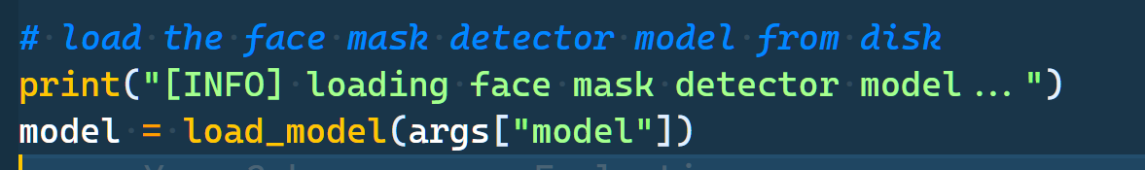

Slide 4
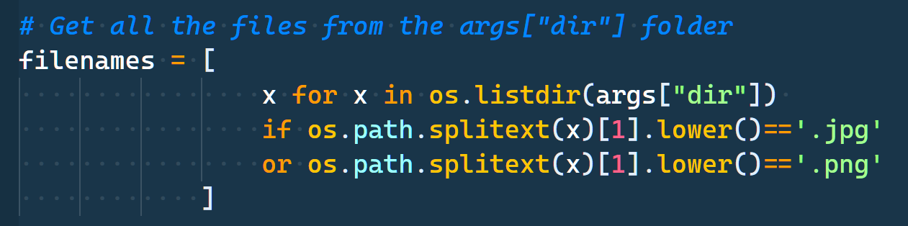

Slide 5
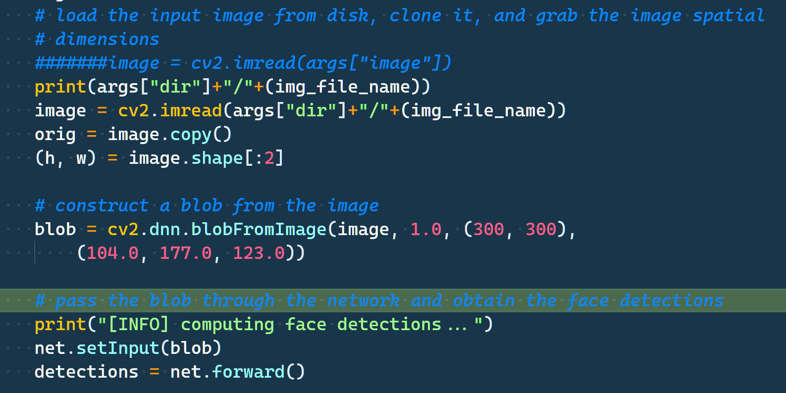
We have a blobFromImage() function which prepares the image in the correct format to be fed into the model. Let us go over all the arguments and learn about them in detail.
image: This is the input image that we just read above using the imread() function.
scalefactor: This value scales the image by the provided value. It has a default value of 1 which means that no scaling is performed.
size: This is the size that the image will be resized to. We have provided the size as 224×224 as most classification models trained on the ImageNet dataset expect this size only.
mean: The mean argument is pretty important. These are actually the mean values that are subtracted from the image’s RGB color channels. This normalizes the input and makes the final input invariance to different illumination scales.
There is one other thing to note here. All the deep learning models expect input in batches. However, we only have one image here. Nevertheless, the blob output that we get here actually has a shape of [1, 3, 224, 224]. Observe that one extra batch dimension has been added by the blobFromImage() function. This would be the final and correct input format for the neural network model.
There are two steps for making predictions.
First, we have to set the input blob to our neural network model that we have loaded from the disk.
The second step is to use the forward() function for forward propagating the blob through the model, which gives us all the outputs.
We are carrying out both the steps in the above code block.
The outputs, which is an array, holds all the predictions.

Slide 6
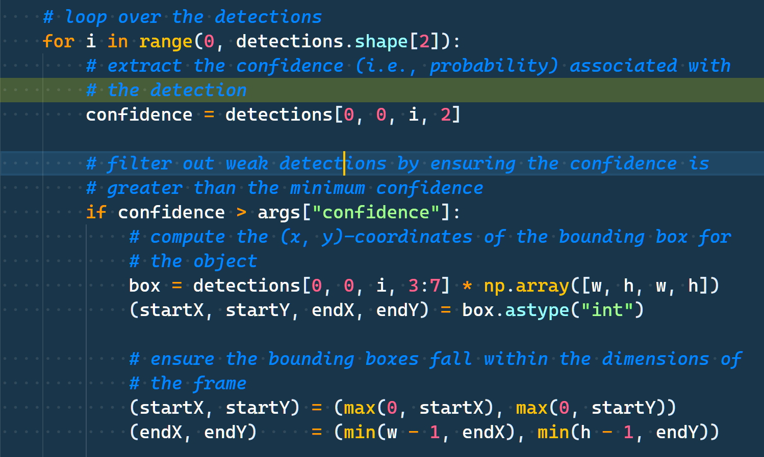
We are all set to loop over the detections in output, and draw the bounding boxes around each of the detected objects. The following is the code for looping over the detections.
Inside the for loop, first, we extract the confidence score of the current detected object. As discussed, we can get it from the index position 2.
Then we have the if block to check whether the detected object’s confidence is above a certain threshold or not. We are only moving forward to draw the bounding boxes of the confidence is above 0.4.
We get the class ID and map it to the MS COCO class names. Then we get a single color for the current class to draw the bounding boxes and put the class label text on top of the bounding box.
We are then extracting the bounding box x and y coordinates and the bounding box’s width and height. Multiplying them with the image width and height, respectively, provides us with the correct values to draw the rectangles.
In the final few steps, we are drawing the bounding box rectangles, writing the class text on top and visualizing the resulting image.

Slide 7
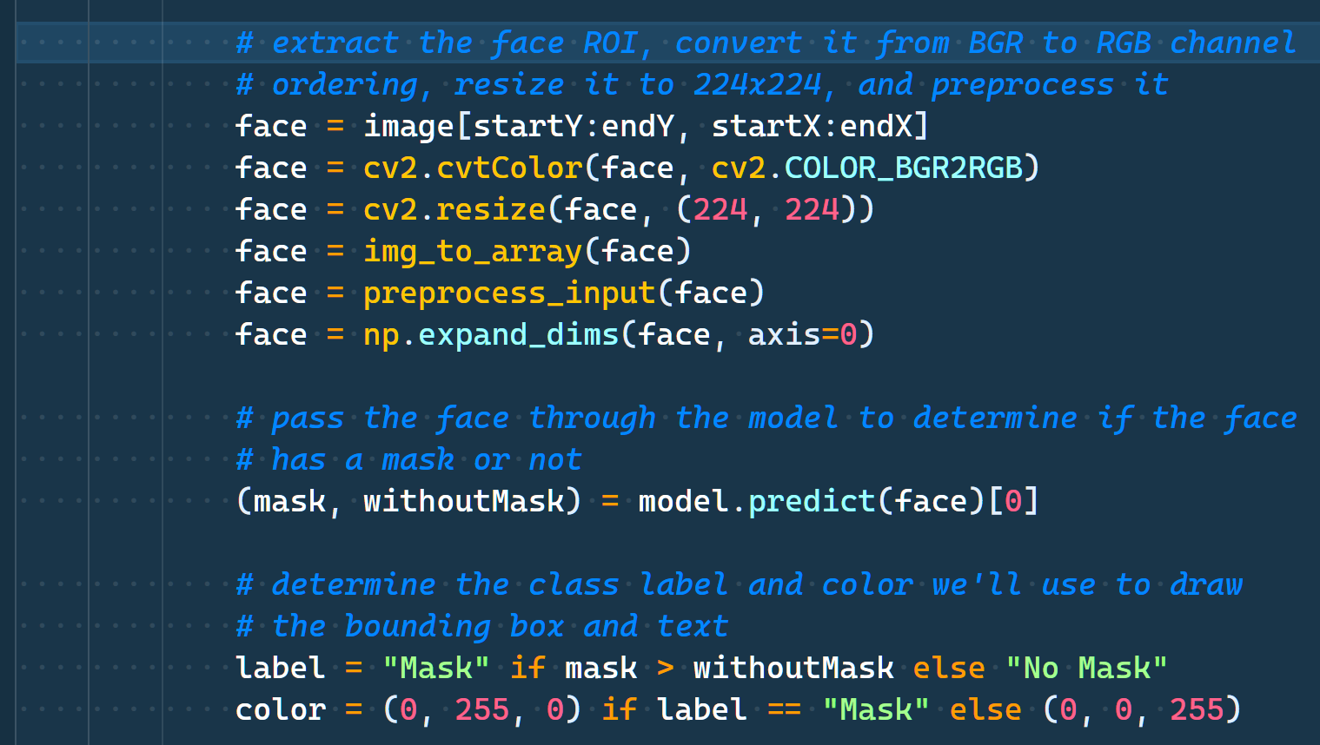
Use MobileNet SSD (Single Shot Detector), which has been trained on the MS COCO dataset using the TensorFlow deep learning framework. SSD models are generally faster when compared to other object detection models. Moreover, the MobileNet backbone also makes them less compute-intensive. So, it is a good model to start learning about object detection with OpenCV DNN.

Slide 8
